Slide 1
Do I Drive More Than The Average American?
Author: Christopher Engelhart
Contact: cs.engelhartmb@gmail.com

Slide 2
Table of Contents:
Part 1: Define
Part 2: Data Collection
Part 3: Data Analysis
Part 4: Conclusion
Part 5: Resources & Misc

Slide 3
Define
Research Question:
Do I drive significantly more miles per day than the average American?

Slide 4
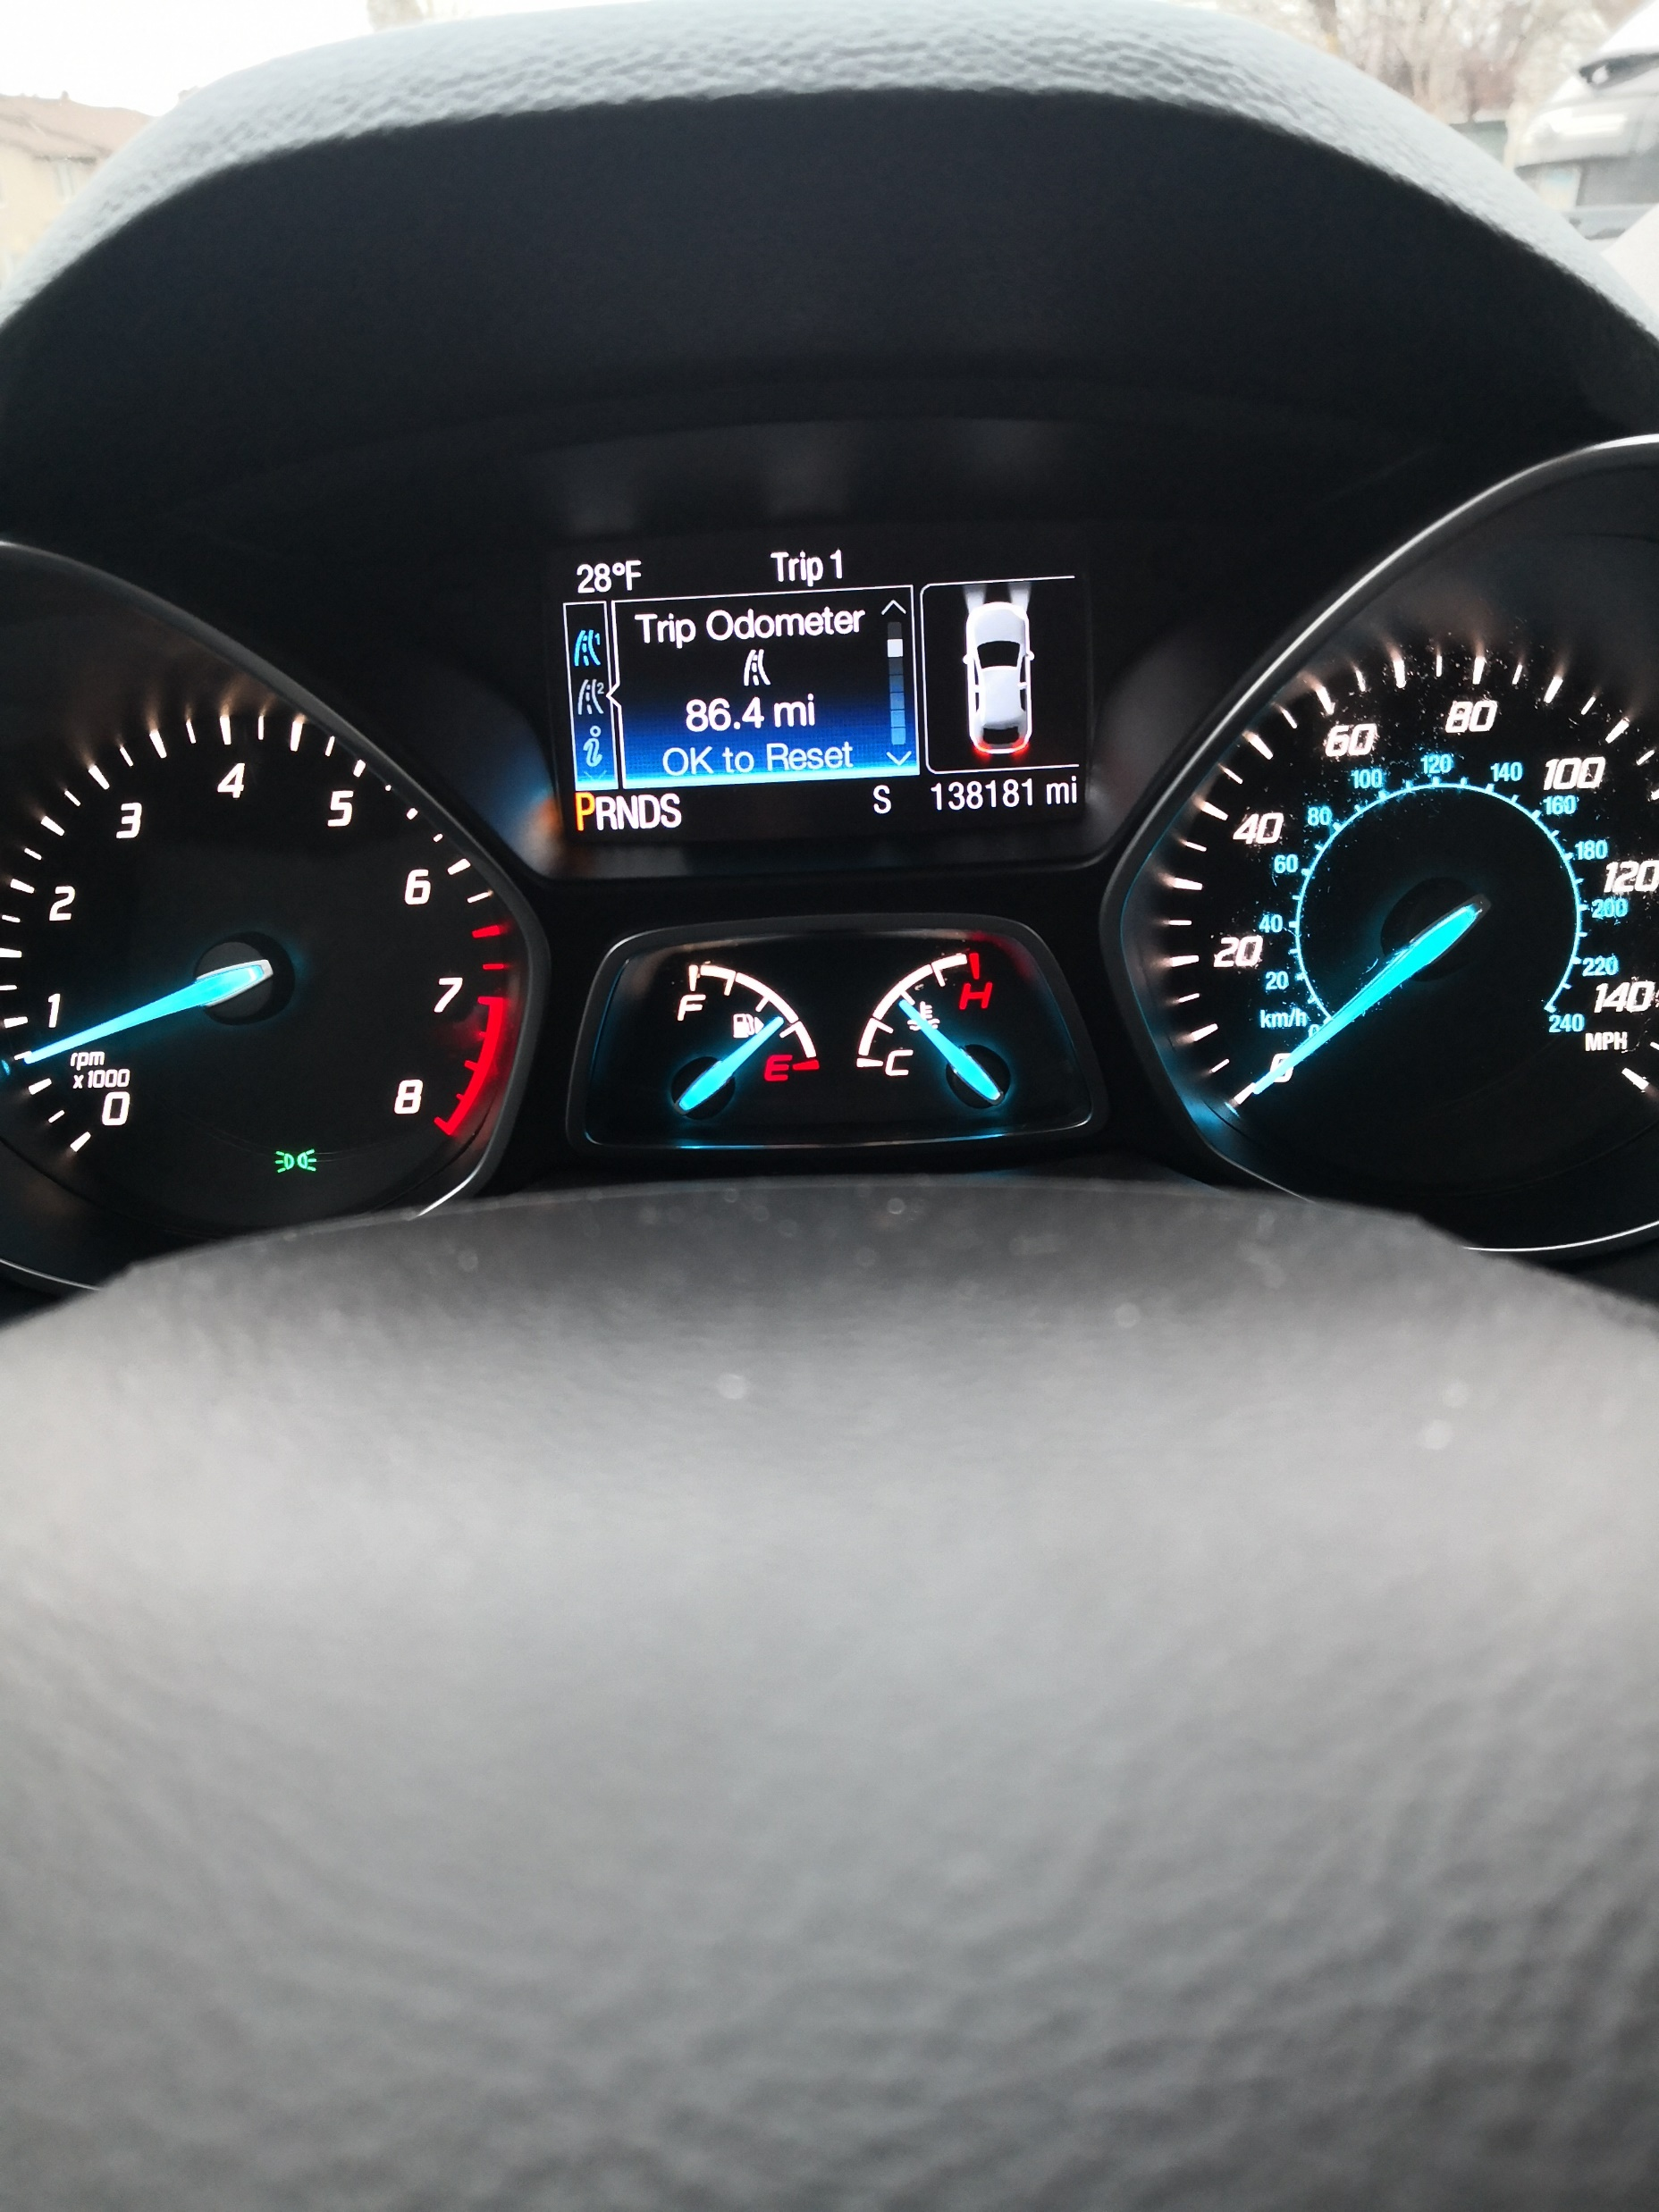
Data Collection
Tracked my daily mileage
From 8NOV2022 – 23NOV2022
Recorded mileage on spreadsheet
Car dashboard app

Slide 5
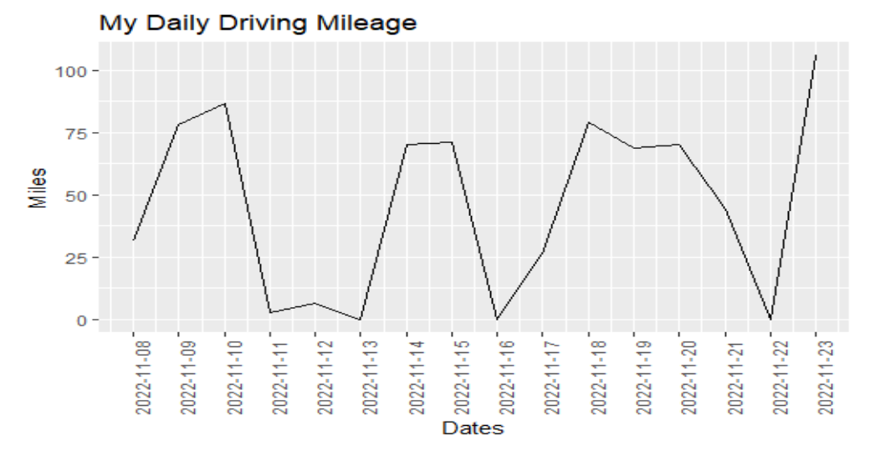
Data Analysis
Imported mileage data into RStudio
Created time series chart for broad overview
Up and down
Corresponds with driving habits

Slide 6
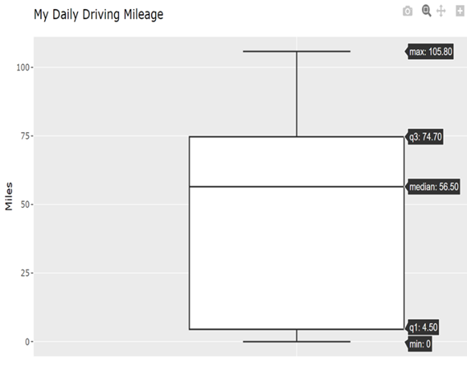
Data Analysis
Statistical five number summary of mileage data
Median closer to Q3 than Q1
Box is big, indicating big IQR
Big IQR points to high variability

Slide 7
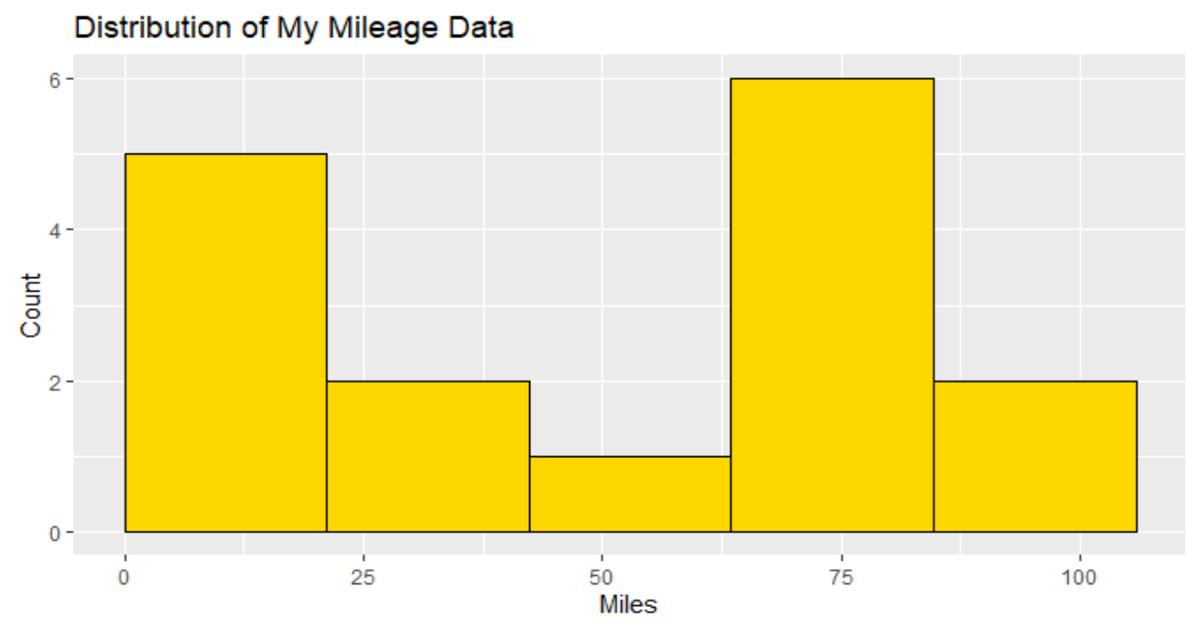
Data Analysis
Distribution of the data
Asymmetric shaped distribution
Bimodal: (1)~ 60-80 miles,
(2) ~0-20 miles
Shows high variability in data

Slide 8
Data Analysis
Mean daily mileage = 46.3 miles
Standard deviation = 36.6 miles
High standard deviation
Mean daily mileage American = 29 miles (per BTS)
Null hypothesis(H0) : µ(Chris) = µ(US)
Alternative hypothesis(Ha) : µ(Chris) > µ(US)
Used one-sample t-test
P-value = 0.04 with 95% confidence interval

Slide 9
Conclusion
p < 0.05, we reject H0
There is sufficient evidence to suggest that I drive significantly more
than the average American

Slide 10
Resources
BTS: https://www.bts.gov/statistical-products/surveys/national-household-travel-survey-daily-travel-quick-facts
GitHub: https://github.com/csengelhart
LinkedIn: https://www.linkedin.com/in/christopher-engelhart/

